Slide 2
Absence of Copyright
This slideshow contains photos, diagrams, and information, some of which were attained through internet searches of public websites. The author of this presentation does not own the copyright on this information, so this slideshow is for personal use only—not for sale or profit. Please utilize it to seek the Lord and grow in your knowledge of His Word and ways.

Slide 4
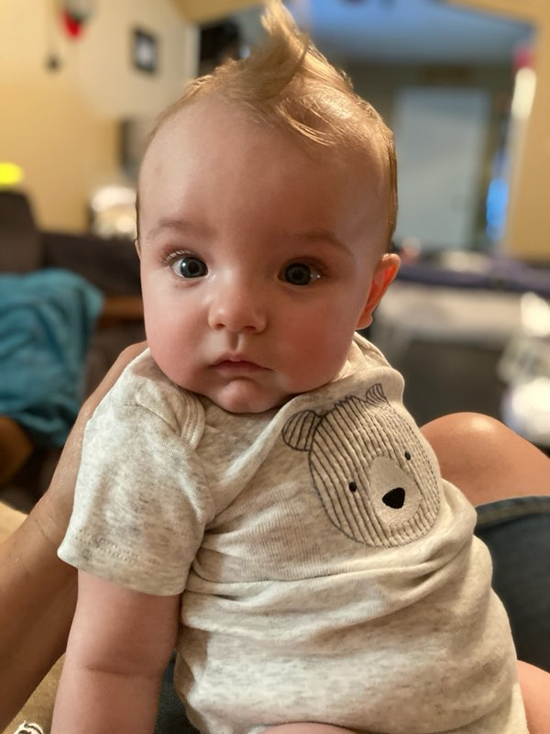
Noah says Hey.

Slide 5
Prayer and Announcements
Sunday: 9:15 Fellowship
9:30 SS Master Class
10:30 Worship
Revelation Study available on our church website
www.faithprinceton.org
Email questions and comments to
pastor@faithprinceton.org

Slide 7
END HERE August 5, 2020
WEEK 13 Revelation 8
BEGIN HERE AUGUST 12, 2020
Notes:
After the sixth seal has been opened (Revelation 6)...
The 144,000 are sealed with the seal of the Living (Loving) God... To mark ownership, protection, and loyalty
In Rev 7:9ff we will hear about a multitude of believers in heaven!

Slide 8
REVELATION CHAPTERS 8-14
The Seventh Seal is opened and gives way to the Seven Trumpet Judgments and Two Interludes.

Slide 9
Notes:
https://stephenshares.weebly.com/book-of-revelation.html

Slide 10
REVELATION CHAPTERS 8-14
The Seventh Seal is opened and gives way to the Seven Trumpet Judgments and Two Interludes.

Slide 11
Revelation 8:1-2 The Seventh Seal
1 When the Lamb broke the seventh seal, there was silence in heaven for about half an hour. 2 And I saw the seven angels who stand before God, and seven trumpets were given to them.
Silence
Trumpet Judgments
Last Trumpet
Notes:
1 When the Lamb broke the seventh seal, there was silence in heaven for about half an hour. =
BAD JOKE: Does that mean there were no women in heaven for the first 30 minutes? ☺
Silence = Reverence! Solemnity! Recognition of the seriousness of the Scroll being opened!!
σιγή, σιγῆς, ἡ (from σίζω (onomatopoetic, Etym. Magn. 712, 29) i. e. to command silence by making the sound st or sch; (yet σιγή probably has no connection with σίζω, but is of European origin (cf. German schweigen) Apparently from sizo (to hiss, i.e. Hist or hush); silence SHHHHH
Tyndale commentary Leon Morris says silence comes so prayers can be heard (vs 3-4)
2 And I saw the seven angels who stand before God, and seven trumpets were given to them. = Referred to as “the Trumpet Judgments”
? Same as the last trumpet in 1 Corinthians 15:51-52 (see also 1 Thess 4)??? SEE REVELATION 11 FOR SEVENTH TRUMPET!
Silence broken in dramatic fashion! Trumpets frequently used for battle commands, victory celebrations, worship, etc.
Newport, Lion and Lamb, 203 “seven angels are believed to be Michael, Gabriel, Raphael, Uriel, Raguel, Sariel, and Remiel”
=======================================================
SAVE THIS FOR REVELATION 11
Matthew 24:29-31 ²⁹ “But immediately after the tribulation of those days the sun will be darkened, and the moon will not give its light, and the stars will fall from the sky, and the powers of the heavens will be shaken. ³⁰ And then the sign of the Son of Man will appear in the sky, and then all the tribes of the earth will mourn, and they will see the Son of Man coming on the clouds of the sky with power and great glory. ³¹ And He will send forth His angels with a great trumpet and they will gather together His elect from the four winds, from one end of the sky to the other.
1 Corinthians 15:51-52 ESV
Behold! I tell you a mystery. We shall not all sleep, but we shall all be changed, in a moment, in the twinkling of an eye, at the last trumpet. For the trumpet will sound, and the dead will be raised imperishable, and we shall be changed.
1 Thessalonians 4:13-18 ESV
But we do not want you to be uninformed, brothers, about those who are asleep, that you may not grieve as others do who have no hope. For since we believe that Jesus died and rose again, even so, through Jesus, God will bring with him those who have fallen asleep. For this we declare to you by a word from the Lord, that we who are alive, who are left until the coming of the Lord, will not precede those who have fallen asleep. For the Lord himself will descend from heaven with a cry of command, with the voice of an archangel, and with the sound of the trumpet of God. And the dead in Christ will rise first. Then we who are alive, who are left, will be caught up together with them in the clouds to meet the Lord in the air, and so we will always be with the Lord. ...
The Seventh Trumpet Revelation 11:15ff.
¹⁵ Then the seventh angel blew his trumpet, and there were loud voices in heaven, saying, “The kingdom of the world has become the kingdom of our Lord and of his Christ, and he shall reign forever and ever.” ¹⁶ And the twenty-four elders who sit on their thrones before God fell on their faces and worshiped God, ¹⁷ saying,
“We give thanks to you, Lord God Almighty, who is and who was, for you have taken your great power and begun to reign. ¹⁸ The nations raged, but your wrath came, and the time for the dead to be judged, and for rewarding your servants, the prophets and saints, and those who fear your name, both small and great, and for destroying the destroyers of the earth.”
¹⁹ Then God's temple in heaven was opened, and the ark of his covenant was seen within his temple. There were flashes of lightning, rumblings, peals of thunder, an earthquake, and heavy hail.

Slide 12
Revelation 8:3-4
3 Another angel came and stood at the altar, holding a golden censer; and much incense was given to him, so that he might add it to the prayers of all the saints on the golden altar which was before the throne. 4 And the smoke of the incense, with the prayers of the saints, went up before God out of the angel’s hand.
Notes:
3 Another angel came and stood at the altar = a place where we find our life altered
holding a golden censer; and much incense was given to him, so that he might add it to the prayers of all the saints = THE IMPORTANCE OF OUR PRAYERS!
V 3-4 Combined with incense to produce worship fragrance before God.
V 5 Combined with fire to produce wrath on earth.
Leon Morris, Tyndale says incense is added to purify the prayers and make them acceptable before God (“they must be cleansed from all taint of selfishness and sin.”)

Slide 13
Revelation 8:5-6
5 Then the angel took the censer and filled it with the fire of the altar, and threw it to the earth; and there followed peals of thunder and sounds and flashes of lightning and an earthquake.
6 And the seven angels who had the seven trumpets prepared themselves to sound them.
Notes:
3 Another angel came and stood at the altar = a place where we find our life altered
holding a golden censer; and much incense was given to him, so that he might add it to the prayers of all the saints = THE IMPORTANCE OF OUR PRAYERS!
Combined with incense to produce worship fragrance before God.
Combined with fire to produce wrath on earth.
prepared themselves to sound them = holding trumpets, but won’t play until the Director waves His baton!!! Prepared, but disciplined.

Slide 14
The Seven Trumpets
Notes:
Leon Morris, Tyndale
Notes that the first four trumpet judgments are reminiscent of the Egyptian plagues in the Exodus.
The fifth and sixth aren’t clearly so, but then:
“In 15:3 the coming of Christ is tacitly compared to the exodus (the redeemed sing the song of Moses and of the Lamb); it is comprehensible, therefore, that the final redemption, the second exodus, is heralded by similar plagues as at the first exodus.”
This verse introduces a new series of events. SEVEN priests blew TRUMPETS in the Old Testament (1Chron 15:24). In Josh 6 the seven trumpets sounded prior to the FALL and DESTRUCTION of Jericho (Josh 6:4). So in Revelation SEVEN angels receive SEVEN TRUMPETS which sound prior to the end of the world.
Number 10:7-10 show the PURPOSE of trumpets:
Call for DELIVERANCE from enemies.
Show GLADNESS
Announce SOLEMN DAYS
Announce the beginning of MONTHS Announce BURNT OFFERING, SACRIFICE and
PEACE OFFERINGS
Acts as MEMORIALS.
NB. The Feast of TRUMPETS HERALDED THE SOLEMN DAY OF ATONEMENT when the ark was seen in Godʼs temple (Lev 23:24-27). Indeed the sounding of the 7th trumpet actually refers to the ark being seen in Godʼs temple in heaven (Rev 11:19).
Sounding trumpets preceeded the DESTRUCTION OF THE ENEMY in the battle of Jericho (Josh 6).
Sounding trumpets also preceeded the DESTRUCTION OF THE ENEMY in the time of Gideon (Jud 7:19-23).
Revelationʼs trumpets therefore point to: WAR; A CALL TO GOD (See Rev 9:20); HERALD THE DAY OF ATONMENT; and preceed THE FALL AND DESTRUCTION OF AN ENEMY OF GODʼS PEOPLE.
??? Interesting view of fall of pagan rome and papal rome ??? https://www.returnofelias.org/post/revelation-8-the-seven-trumpets

Slide 15
Notes:
First four trumpets followed by three “woes”

Slide 16
Revelation 8:7 The First Trumpet
7 The first sounded, and there came hail and fire, mixed with blood, and they were thrown to the earth; and a third of the earth was burned up, and a third of the trees were burned up, and all the green grass was burned up.
Hail, Fire, and Brimstone – Ezekiel 38 @ Gog
Revelation 9,14, 19, 20, 21
Notes:
Preaching HELLfire and brimstone or Hail, Fire, and Brimstone
Compare to plague of hail in Exodus 9:23-26 and Fire and Blood in Joel 2:30

Slide 17
Revelation 8:8-9 The Second Trumpet
8 The second angel sounded, and something like a great mountain burning with fire was thrown into the sea; and a third of the sea became blood, 9 and a third of the creatures which were in the sea and had life, died; and a third of the ships were destroyed.
Notes:
Compare to turning Nile to blood in Exodus 7:20-24
Hal Lindsey = thought this sounded like thermonuclear war on naval seas

Slide 18
Revelation 8:10-11 The Third Trumpet
10 The third angel sounded, and a great star fell from heaven, burning like a torch, and it fell on a third of the rivers and on the springs of waters. 11 The name of the star is called Wormwood; and a third of the waters became wormwood, and many men died from the waters, because they were made bitter.
Notes:
Fresh water pollution
First Egyptian plague on the Nile... ALSO... The reverse of the waters of Marah in Exodus 15:23
Newport, 205: Wormwood symbolizes divine punishment, as Jeremiah’s words indicate: “I will fee this people with wormwood, and give them poisonous water to drink” (Jer 9:15; compare 23:15; Lam. 3:15, 19).
Hal Lindsey believed this star was a thermonuclear weapon which will contaminate all of the fresh water sources on earth.

Slide 19
Revelation 8:12 The Fourth Trumpet
12 The fourth angel sounded, and a third of the sun and a third of the moon and a third of the stars were struck, so that a third of them would be darkened and the day would not shine for a third of it, and the night in the same way.
Notes:
Compare plague of darkness in Exodus 10:21-23
Hal Lindsey = thought it would be a darkness caused by fallout pollution from nuclear war (“nuclear winter”???)

Slide 20
Revelation 8:13 The Coming Woes
13 Then I looked, and I heard an eagle flying in midheaven, saying with a loud voice, “Woe, woe, woe to those who dwell on the earth, because of the remaining blasts of the trumpet of the three angels who are about to sound!”
Notes:
END OF CHAPTER 8
An eagle that speaks human language?

Slide 21
END HERE August 12, 2020
WEEK 14 Revelation 9
BEGIN HERE AUGUST 19, 2020

